Slide 1
Collaborative Self-Attention Network for Session-based Recommendation
汇报人：Gu Tang
时间：2020.11.14
Conference：IJCAI_2020
Github: None

Slide 2
Motivations
Existing session-based methods have the following limitations:
1):They either lack the capability to learn complex dependencies or focus mostly on the current session without explicitly considering collaborative information
2):They assume that the representation of an item is static and fixed for all users at each time step
V1,0,0,0,0,0 --->V2
V1,V2,0,0,0,0 --->V2
V3,0,0,0,0,0 --->V5
V4,V3,V5,0,0,0--->V5

Slide 3
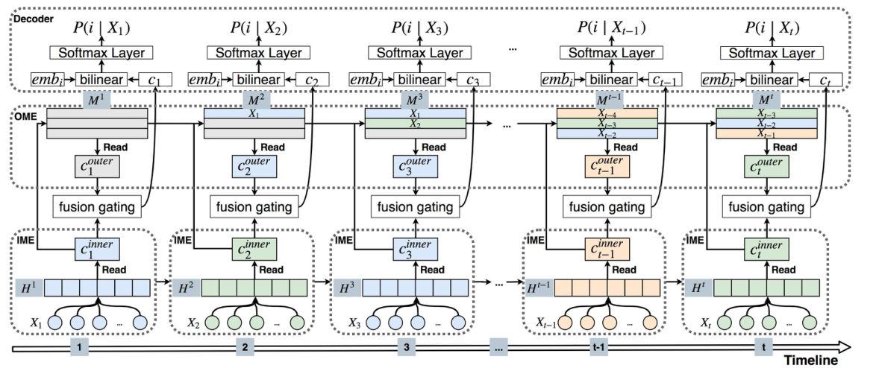
Base work-CSRM
SIGIR_2019_A collaborative session-based recommendation approach with parallel memory modules

Slide 4
CSRM

Slide 5
CSRM

Slide 6
CoSan Prepare-data
V1
:[1,3,4]
Session 1
V1
V1
V2
V3
V2
:[1,4]
Session 2
V3
:[1,2]
V3
V4
V5
V4
:[2]
Session 3
V1
V6
V1
V4
V5
:[2,4]
Session 4
V6
V5
V4
V1
V2
V6
:[3,4]

Slide 7
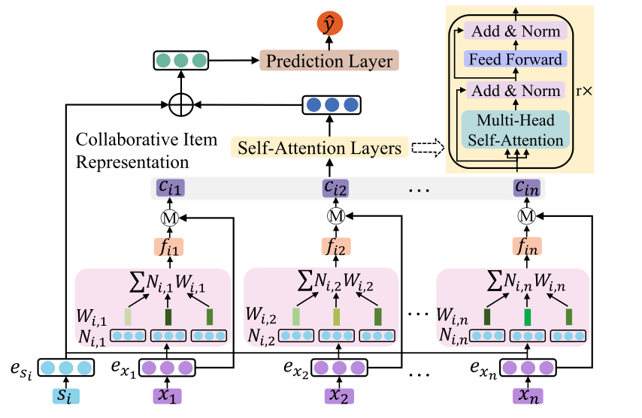
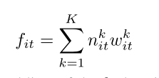
CoSan-Framework

Slide 8
CoSan-Framework

Slide 9
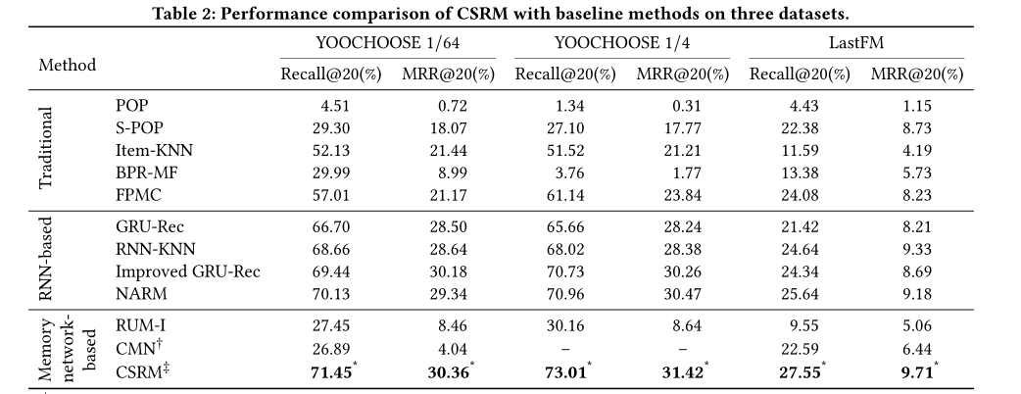
Experiment

Slide 10
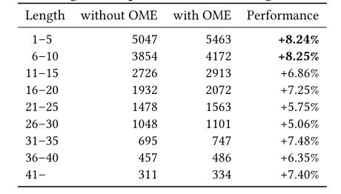
Experiment
CoSAN
CSRM

Slide 11
THANGKS!

